Slide 1

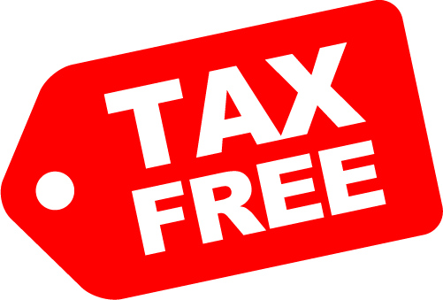
“In this world, nothing can be said to be certain except death and taxes.”
- Benjamin Franklin

Slide 2
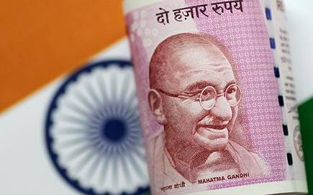
Introduction to Goods and Services Tax (GST)
- Krishnan R
SIES ASC, Sion (W)

Slide 3
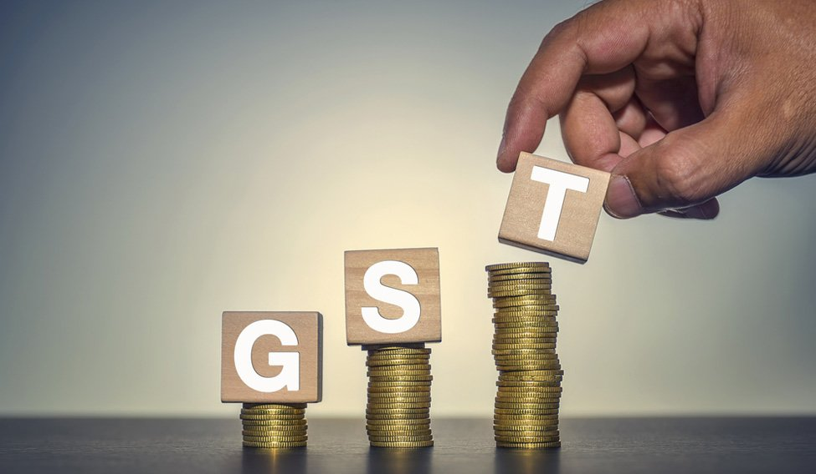
What is GST (India)?
An indirect tax levied on supply of goods and services at national level.
Collected by merchants at every stage of production / value addition and deposited to the Government.
Governed by GST Council of India and is under the purview of Central Board of Indirect Taxes and Customs.
Launched on 1st July, 2017 by fomer President, Dr. Pranab Mukherjee by passing GST Act.
Since inception, GST rules in India have been going through continuous alterations by way of amendments.

Slide 4

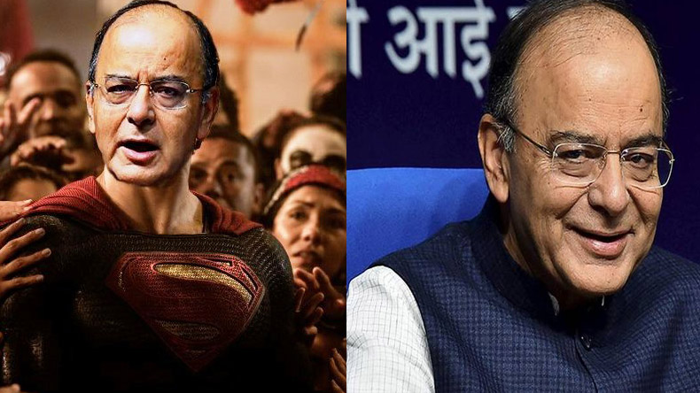

Taxes subsumed under GST
State Taxes | Central Taxes
VAT / Sales Tax | Central Excise Duty
Entertainment Tax | Additional Excise Duty (Textile and Textile products and goods of special importance)
Luxury Tax | Additional Customs Duty (CVD)
Tax on Lottery / Betting / Gambling | Special Additional Duty (SAD)
Octroi / Entry Tax | Service Tax
Purchase Tax | Central Cesses and Surcharges

Slide 5

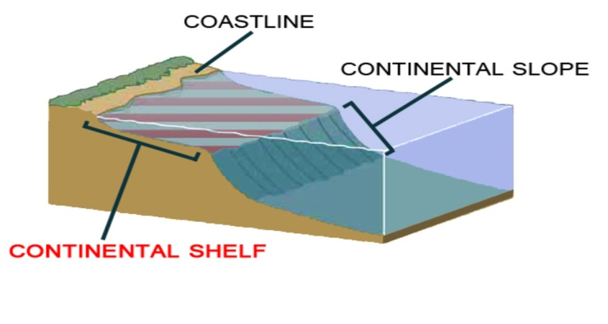
Coverage of GST
”GST is applicable to the whole of India”
Air space above India's territory and territorial waters
Continental Shelf (upto 200 NM)
Exclusive Economic Zones (upto 200 NM)
Other Maritime Zone
Territorial Waters: Extends up to12 nautical miles from basline
Delhi and Puducherry: Treated at par with states (SGST)
A&N Islands, Lakshadweep, Dadra & Nagar Haveli, Daman and Diu J&K, Ladakh and Chandigarh: Adopt UTGST
Seabed and subsoil underlying territorial waters

Slide 6
Key Concepts
Business: an entity engaged in trade, commerce, manufacture, profession, association, society, gate-keeping, club, vocation adventure, wager or an activity in connection to the same.
Consideration: Any payment made or to be made but does not include subsidy provided by the CG or SG.
E-Commerce Operator: A person who owns, operates or manages digital facility or platform for e-commerce.
Goods: Every kind of movable property other than money and securities but includes actionable claims, growing crops, grass and things attached to or forming a part of land agreed to be severed under a supply contract.
Service: Anything other than goods, money and securities, but includes conversion form to another, for which a consideration is charged.
Supplier: A person supplying goods and services and includes agents acting on behalf such suppliers.
Recipient: (a) a person liable to pay consideration for goods or services or both;
(b) A person to whom goods are delivered without consideration;
(c) An agent acting on behalf of the final recipient of goods or services of both.

Slide 7
Taxable Supply: Supplies that are chargeable to tax.
Non-Taxable Supply: Supplies which are not leviable to tax under GST Act.
Exempt Supply: Supplies which attract NIL rate of tax or wholly exempted from tax.
Person: Includes an individual, HUF, Firm, LLP, Body Corporate, Corporation, Local Authority, Company, CG, SG, Artificial Juridical Person, Trust, AOP, BOI, Cooperative Society.
Taxable Person: A person who is registered or liable to be registered.
Principal Supply: Supply of goods and services which constitutes the predominant element of a composite supply and other service forming a part is ancillary.
Aggregate Turnover: Aggregate value of taxable supplies, exempt supplies, export of goods or services, inter state supplies of persons having same PAN. (Excludes Central Tax, State Tax, UT Tax, Integrated Tax, Cess and RCM)

Slide 8
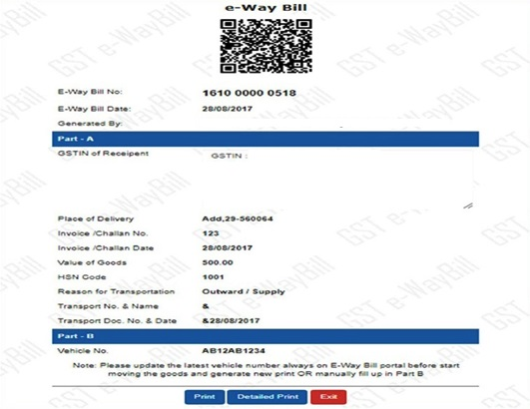
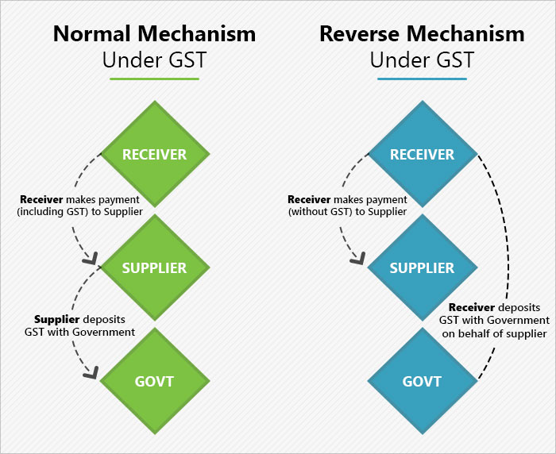
E-Way Bill: An electronic document generated on the GST portal evidencing movement of goods.
Part A – GSTIN, place of delivery, invoice no. and date, value of goods, HSN Code, transport document number (GR, RWB, AWB, BL) and reason for transportation.
Part B – Transporter details.
Reverse Charge Mechanism: Tax payment liability arises on the recipient instead of supplier of the goods or services.

Slide 9
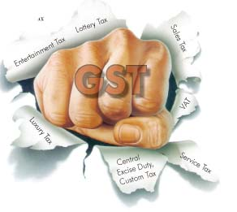
Need for GST
To get rid of too many taxes levied by Centre and States.
To stop Cascading of Taxes (tax pe tax, as CG taxes were not available as set off against SG taxes and vice versa)
Different practices by different states.
To have authenticated and free flow of trade. (by knocking out octroi, entry tax, LBT, etc)
To save tax payer’s time and money in filing and tax payment.
To have a “harmonized” system of indirect taxation. HSN – Harmonized System of Nomenclature to classify goods universally in a systematic manner. Contains a 6 digit code that classifies 5000 plus goods all over the world.
To have a single tax for entire supply chain.
To have a strong base with IT aid to have a better tax compliance.

Slide 10

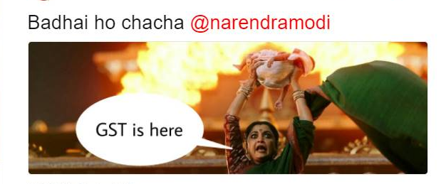

GST ke लाभ....
One Nation, One Tax
Low Taxes
Lower Cost
Boost to Make in India
Enhance Exports
Beneficial to small enterprises by way of higher threshold and composition scheme.
Uniform Tax
Simplified and automated procedures and record keeping.
Advanced IT enabled services (GSTN)
Employment generation
No tax evasion
Higher revenue for the Govt.

Slide 11
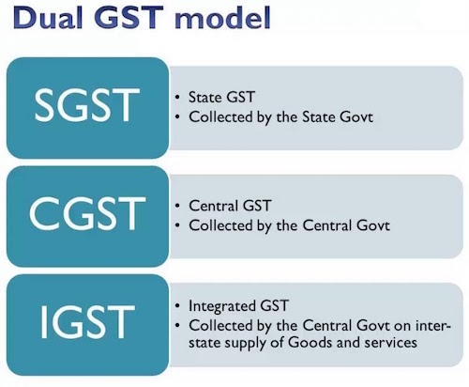
Replaced State VAT, Entry Tax, Octroi, etc. (SGST Act, 2017)
Replaced Central Excise Duty and Service Tax (CGST Act, 2017)
Charged by the Supplier.
Exporting State transfers SGST portion to CG and CG transfers that SGST to the importing state

Slide 12

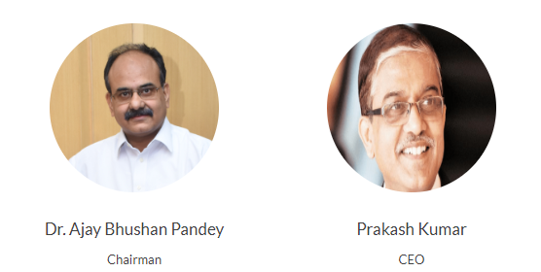
Goods and Services Tax Network
Technological backbone for GST in India.
Set up by the Govt of India with stakes equally held by State and Center Govt. (Approved in April 2018) Prior, Govt Share: 49% and Non Govt Fin Inst Share: 51%
Infosys has been appointed as Managed Service Provider (MSP)
GSTN got 73 IT, IT enabled services, financial tech companies and 1 Commissioner of Commercial Taxes (GST Suvidha Providers)
GSTN to provide three front end services like registration, payment and filing of return.
GSTN to facilitate computation and settlement of IGST.
Providing MIS Reports to CG and SG as per tax-payers return information.
Manage matching engine for matching, reversal and claim of ITC.
Accounting of fund transfers between SG and CG.
Developing back end process like assessment, audit, refund, appeal, etc.

Slide 13

GST Council
Powered by Article 279A of the Indian Constitution to constitute a joint forum of Centre and States.
Members
- Union Finance Minister (Chairperson)
- Union Minister of State in charge of Revenue or Finance (Member)
- Minister in charge of Finance or Taxation (Members)
Recommendations on
- Taxes, cesses, surcharges levied by State and Union which is to be subsumed by GST.
- List of goods and services to be taxable or exempted.
- Lay down principles regarding levy of GST.
- Threshold limit for registration and payment of GST.
- Band of Tax Rates for goods and services.
- Provision of Special Category States.
- Guiding principles and amendments.

Slide 14

Scope of Supply [Sec 7]
Sale, Transfer, Barter, Exchange, License, Rental, Lease, Disposal, etc. for consideration in course of furtherance of business. (1)(a)
Import of services for consideration whether or not in course of furtherance of business. (1)(b)
Specific supply made or agreed to be made without consideration. (1)(c) Sch I
Activities to be treated as deemed supply of goods or services. (1)(d)/Sch II
Excludes Negative List of Supply [Sec 7(2)] and Schedule III
Permanent transfer / disposal of business assets where ITC has been availed on such assets.
Supply between related or distinct taxable persons, when made in the course of furtherance of business. (Except gift not exceeding Rs. 50,000 in value by employer to employee.
Supply of goods by
Principal to his agent where agent undertakes to supply such goods on behalf of the principal or
Agent to principal where the agent undertakes to receive such goods on behalf of principal.
Importation of services by a taxable person from a related person or from any of his other establishments outside India, in the course of furtherance of business.

Slide 15
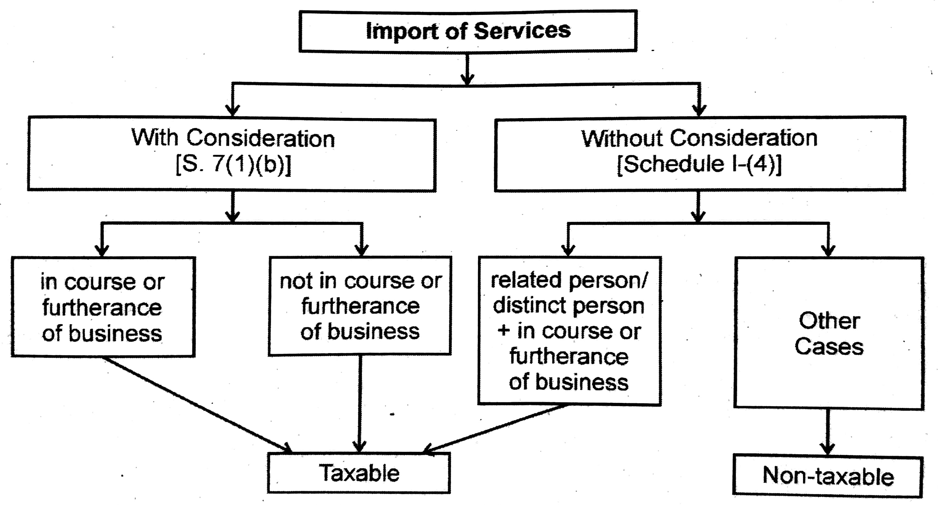

Slide 16

Deemed Supply of goods or services (1)(d)Sch II
1. Transfer
(a) Title in goods
(b) Transfer of right
(c) Instalment Sale / Hire Purchase / Financial Lease
2. Land and Building
(a) Any lease, tenancy, easement, license to occupy land
(b) Any lease of building for business or commerce
3. Treatment / Process applied to another person’s goods
for eg. Job work performed by a job worker

Slide 17
4. Transfer of Business Assets
(a) Transfer or disposal of goods
(b) Business goods used for personal purpose
(c) Cessation being a taxable person
5. Supply of Services
(a) Renting of immovable property (except for residence)
(b) Construction
(c) Intellectual Property Rights (Temporary transfer, permitting use and enjoyment)
(d) IT Software (Development, licence to use and sale)
(e) Agree to refrain from/tolerate/do an act (Demurrage, non-compete agreement for a fee, notice pay)
(f) Transfer of right to use any goods

Slide 18
6. Composite Supplies
(a) Works Contract
(b) Supply of food or any article for human consumption or any drink
7. Supply of goods by AOP/BOI to its member

Slide 19



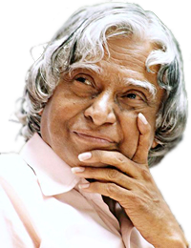

Items not covered under GST (non - taxable) 7(2)(a)/Sch III
GST is not applicable on following goods and services. They are classified under Schedule III of GST Act as “ Neither goods nor services”
Services by an employee to the employer in relation to employment.
Court/Tribunal Services including District Courts, High Courts and the Supreme Court.
Duties performed by
Members of Parliament,State Legislature, Panchayats, Municipalities and other local authorities.
Person holding post under the provisions of the Constitution.
Chairperson/Member/Director in a body established by the govt or local autority and who is not employee of the same.

Slide 20
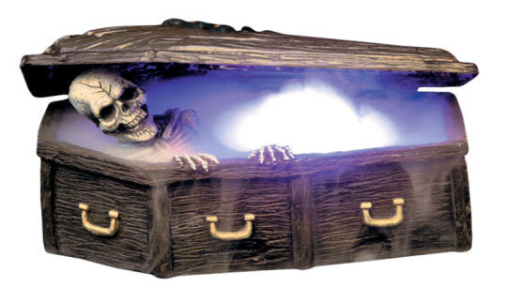

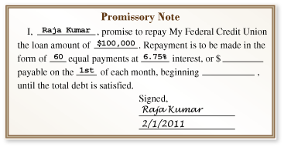
4. Services of funeral, burial, crematorium or mortuary including transportation of the deceased.
Sale of land and sale of building
Actionable claims like book debts, bill of exchange, promissory note other than lottery, betting and gambling.
* Actionable claims are neither goods nor services but they are something in liue of money.
* Lottery, betting and gambling attract 28% GST

Slide 21
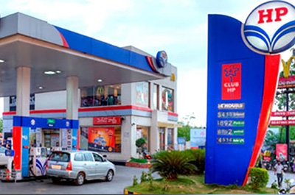
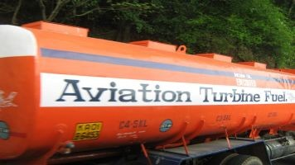
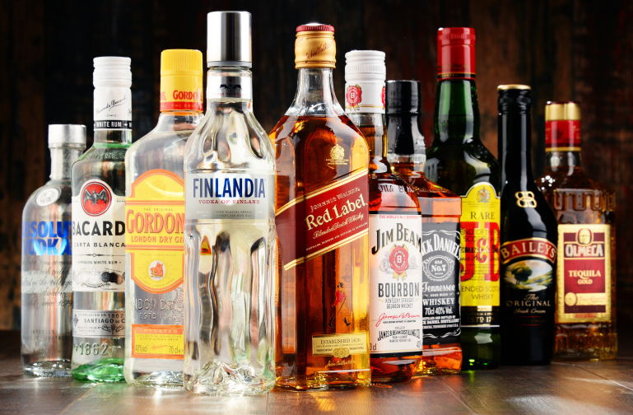
Apart from Schedule III, GST is not applicable on the following:
*Basically, these goods are beyond the scope of GST
Petroleum Products
Tax on Petroleum Crude/HIgh Speed Diesel/Motor Spirit/Natural Gas/Aviation Turbine Fuel. Same previous rule of VAT/CST and Excise is being followed by states.
Alcohol
Liquor for human consumption. Same previous rule of VAT/CST and Excise is being followed by states.

Slide 22
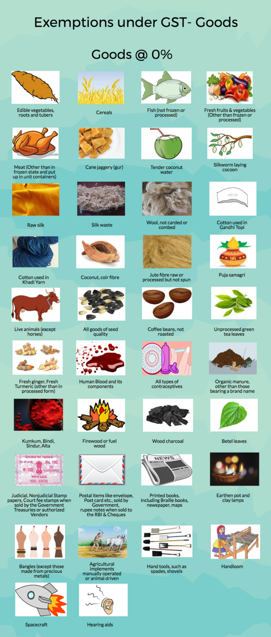
Goods Exempted under GST - NIL Rated

Slide 24

Services Exempted under GST - NIL Rated
Govt/Local Authority services except Post Office services provided to a person other than govt, services in relation to aircraft or a vessel inside or outside an airport or port, transport of goods or passengers.
RBI
Foreign Diplomatic Mission located in India.
Cultivation of plants and rearing of all animals, except horses.
Access to road or a bridge on payment of toll charges.
Transmission or distribution of electricity by an electricity or distribution utility.
Renting of residence building for use as residence.
Transportation of goods by road (except GTA and Courier Agency) and inland waterways.
Vet Clinic
Services of an arbitral tribunal to any person (except business) and a business entity with turnover below GST threshold in the PY.

Slide 25
A partnership firm or an individual advocate (except senior), providing legal services to another partnership firm/individual providing legal services, any person (not business), business entity with turnover below GST threshold in PY.
Education (pre-school to high school) including transportation to students, teachers and staff; mid day meals and other catering, security and house keeping and admission to institution or conduct of examination.
Performance in folk or classical music or dance or theatre (consideration less than Rs. 1,50,000) [no exemption if the artist is a brand ambassador]
Independent journalist, Press Trust of India or United News of India collecting or providing news.
Transport of passengers by (a) air, embarking or terminating in an airport located in Arunachal Pradesh, Assam, Manipur, Meghalaya, Mizoram, Nagaland, Sikkim or Tripura or Bordoga (WB); (b) Non AC contact carriage other than radio taxi, for transportation of passengers, excluding tourism, charter on hire. (Kolkata to Joka Jeeps); (c) Non AC horse carriage.
Health care services by a clinical establishment, a doctor or para medic; ambulance service.
Services provided by the GSTN to Government (State or Centre)
Services by a person by way of (a) conduct of religious ceremony; (b) renting of precincts of a religious place.
Renting of rooms with charges less than Rs. 1,000 per day.
Loading, unloading, packing, storage or warehousing of rice.

Slide 26
Transport in goods carriage of (a) agricultural produce; (b) goods, where gross amount charged is less than Rs. 1,500; (c) goods, where gross amount charged for all goods for a single consignee is less than Rs. 750; (d) milk, salt, food grains and newspapers.
Admission to (a) circus, dance, theatrical performanceincluding drama or ballet; (b) award function, concert, pageant, musical performance or any sporting event other than a recognized sporting event; (c) recognized sporting event where admission price is less than Rs. 250 per person.
Services by way of transportation by rail or a vessel from one place in India to another for (a) Relief materials meant for victims of natural or man-made disasters, calamities, accidents or mishap; (b) Defence or military equipments; (c) Newspaper or magazines registered with the Registrar of Newspapers; (d) Railway equipments or materials; (e) Agricultural produce; (f) Milk, salt and food grain including flours, pulses and rice; and (g) Organic manure.
Service of transportation of passengers, with or without accompanied belongings by (a) Railways in a class other than First class; or air-conditioned coach; (b) Metro, monorail or tramway; (c) Inland waterways; (d) Public transport, other than predominantly for tourism purpose, in a vessel between places located in India; and (e) Metered cabs or auto rickshaws (including E-rickshaws)

Slide 27
Composite Supply
Tax Liability – Tax Rate applicable to the Principal Supply
Mixed Supply
Tax Liability – Highest Tax Rate applicable
One Principal Supply
2 or more taxable supplies of goods/services
Naturally bundled
Single Price
2 or more supplies of goods/services
Not a Composite Supply

Slide 28
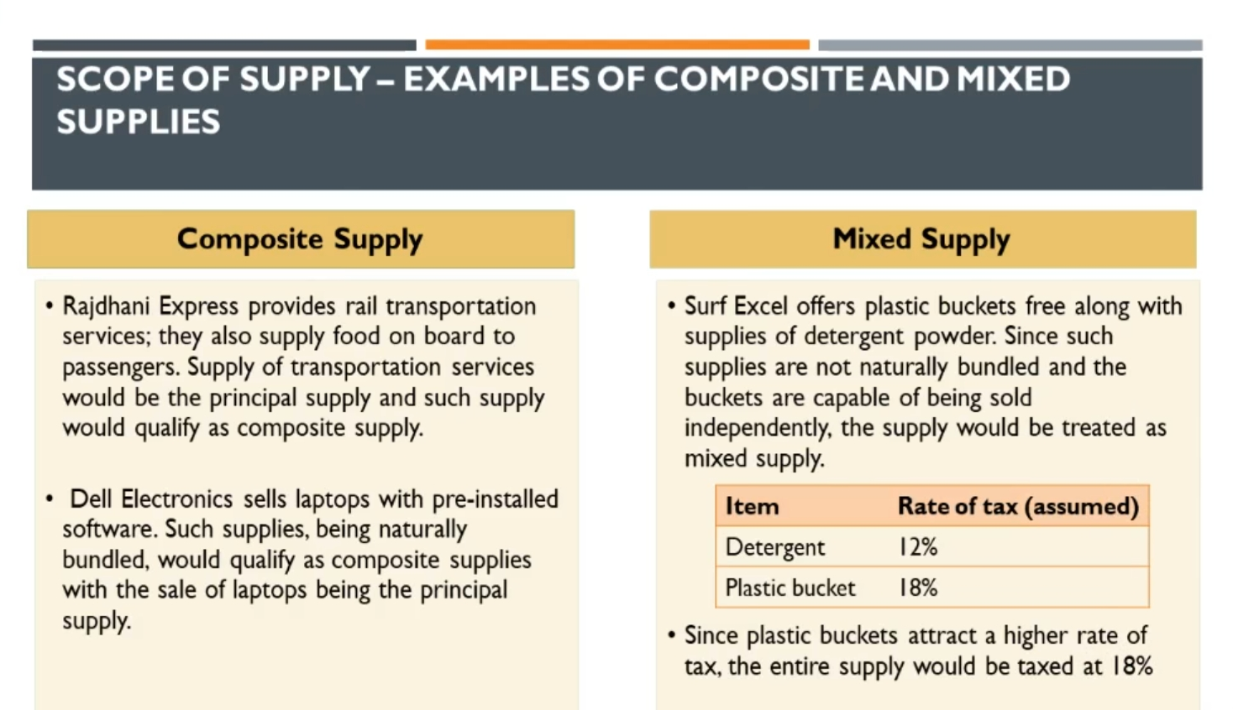

Slide 29


